Slide 1
Decision Table Based Testing in Software Testing
UNIT3

Slide 2
What is a Decision Table :
Decision tables are used in various engineering fields to represent complex logical relationships. This testing is a very effective tool in testing the software and its requirements management. The output may be dependent on many input conditions and decision tables give a tabular view of various combinations of input conditions and these conditions are in the form of True(T) and False(F). Also, it provides a set of conditions and its corresponding actions required in the testing.

Slide 3
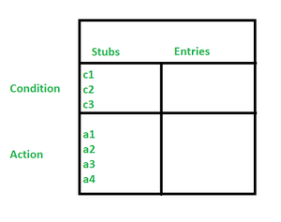
Parts of Decision Tables :
In software testing, the decision table has 4 parts which are divided into portions and are given below :

Slide 4
Parts of Decision Tables :
Condition Stubs : The conditions are listed in this first upper left part of the decision table that is used to determine a particular action or set of actions.
Action Stubs : All the possible actions are given in the first lower left portion (i.e, below condition stub) of the decision table.
Condition Entries : In the condition entry, the values are inputted in the upper right portion of the decision table. In the condition entries part of the table, there are multiple rows and columns which are known as Rule.
Action Entries : In the action entry, every entry has some associated action or set of actions in the lower right portion of the decision table and these values are called outputs.

Slide 5
Types of Decision Tables :
The decision tables are categorized into two types and these are given below:
Limited Entry : In the limited entry decision tables, the condition entries are restricted to binary values.
Extended Entry : In the extended entry decision table, the condition entries have more than two values. The decision tables use multiple conditions where a condition may have many possibilities instead of only ‘true’ and ‘false’ are known as extended entry decision tables.

Slide 6
Applicability of Decision Tables
The order of rule evaluation has no effect on the resulting action.
The decision tables can be applied easily at the unit level only.
Once a rule is satisfied and the action selected, n another rule needs to be examined.
The restrictions do not eliminate many applications.

